Slide 1
Building accessibility community & systems for the long haul
Devon Persing
Tech Access Oklahoma 2025

Slide 2
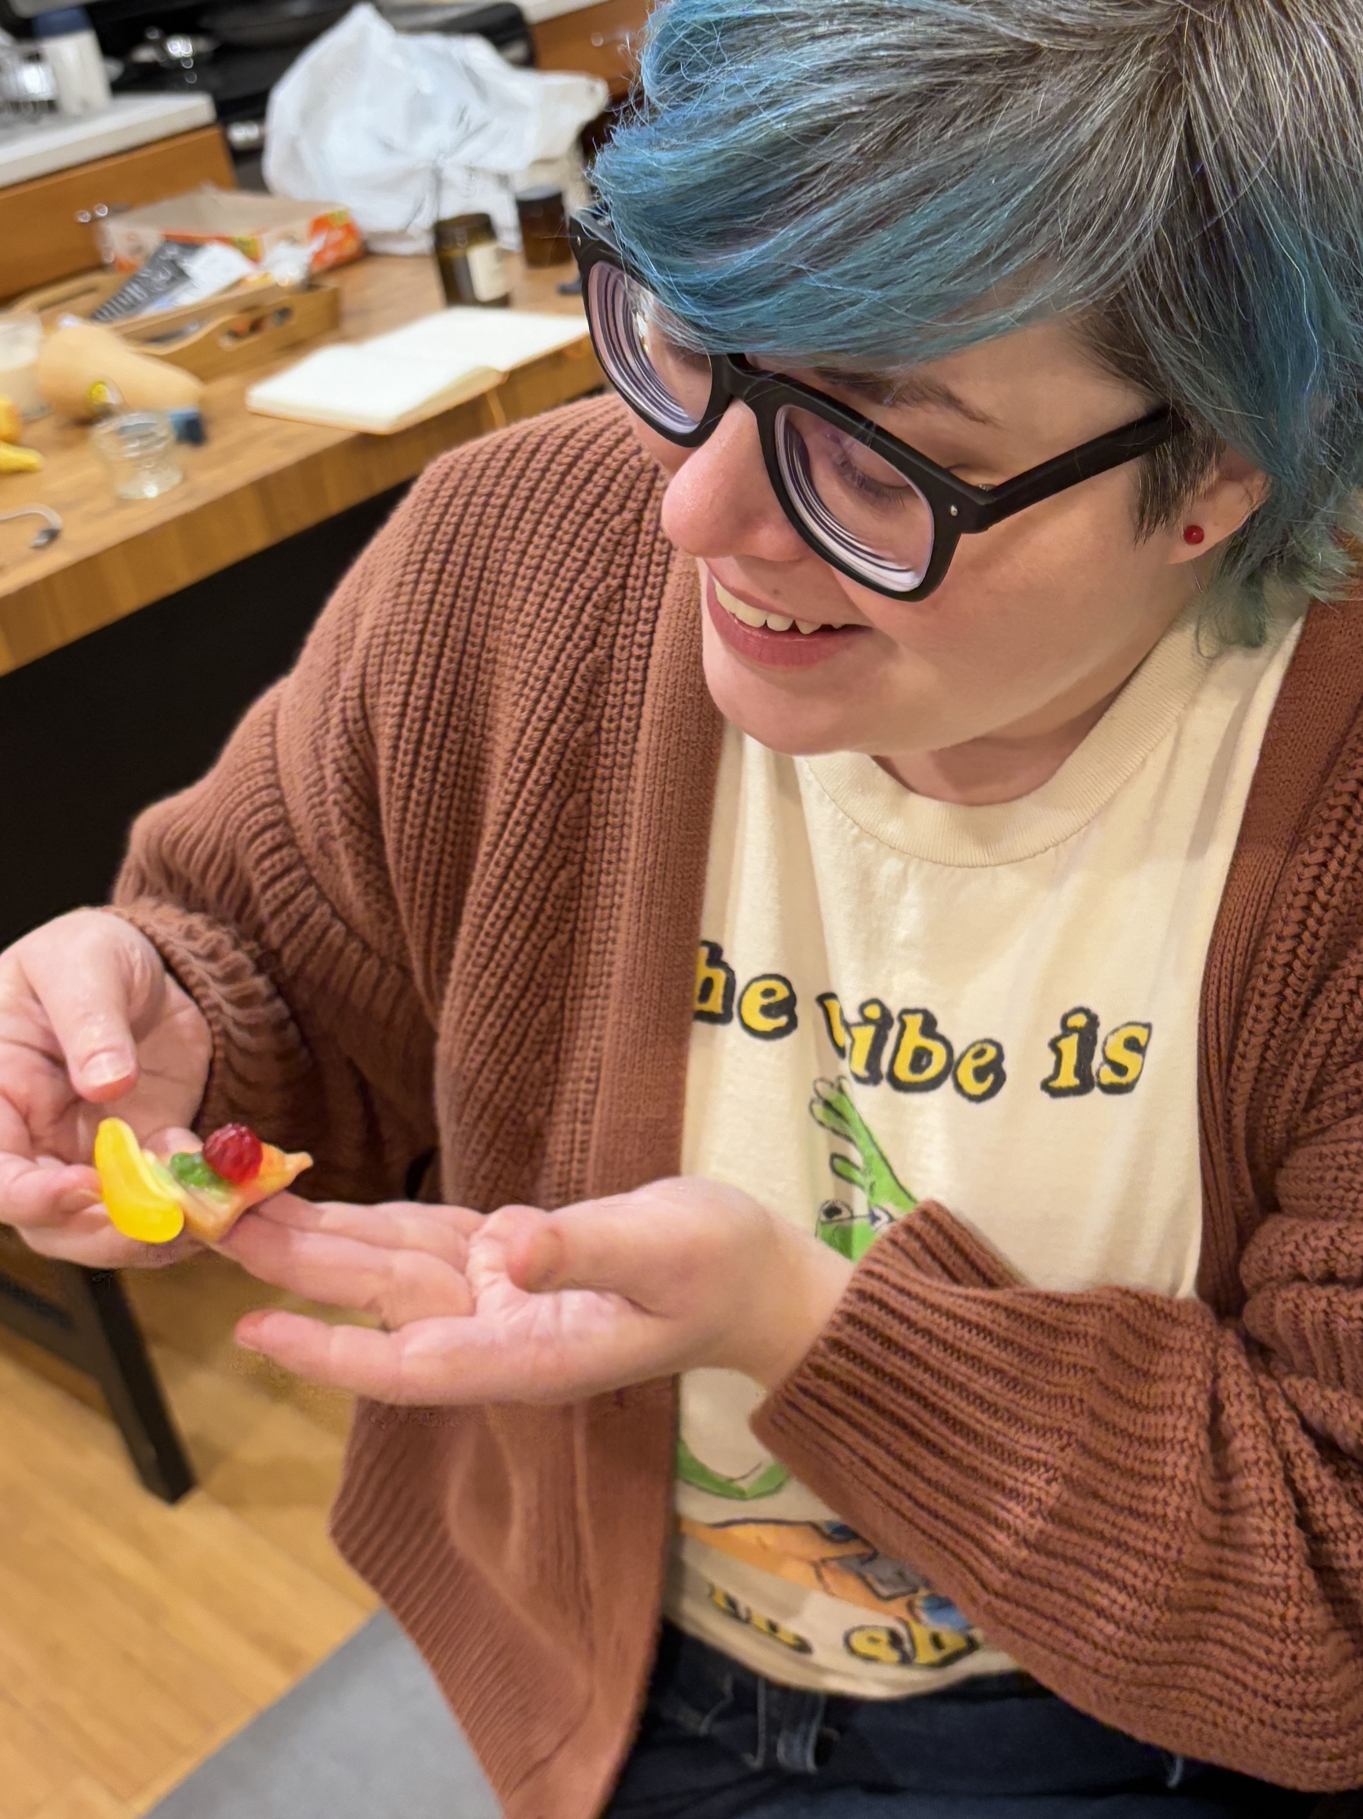
About me
Independent digital accessibility consultant
In the accessibility field since 2012
Disabled, chronically ill, and neurodivergent
Based in Duwamish Territory/ Seattle, WA

Slide 3
Topics
Why community matters
Why systems matters
Getting started with accessibility operations

Slide 4
Why community matters

Slide 5
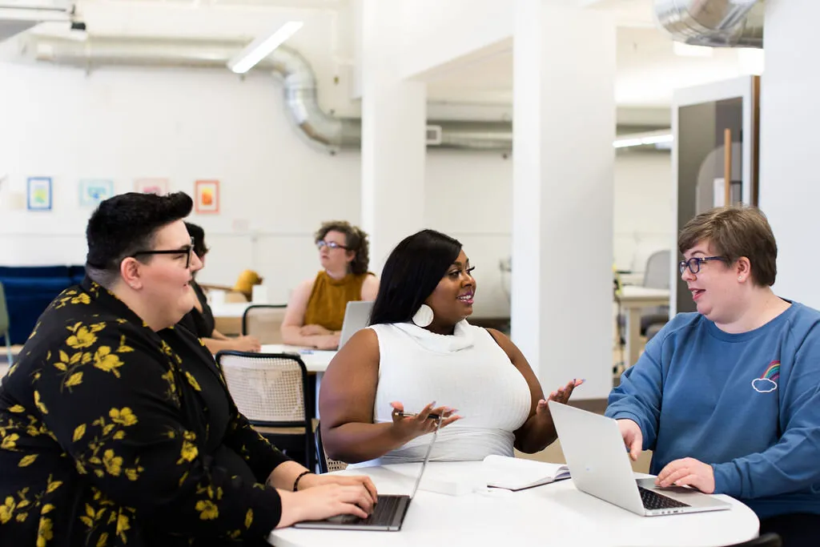
None of us can do this work alone.
Notes:
Source: https://canweallgo.com/plus-size-stock-photos/plus-size-stock-photos-office-work-employment/

Slide 6
What is accessibility community about?
Affinity
Trust
Climate
What brings us together
What keeps us together
What we have (some) control over

Slide 7
Affinity*
Shared values
Shared commitments
Shared passions
*aka “solidarity” or “coalition”
Notes:
Shared:
Strategy
Justice
Calls to action
Learning
Ideas
Protection

Slide 8
Affinity is like a Venn diagram

Slide 9
Breakfast
Oatmeal
Eggs
Coffee
Notes:
For example, oatmeal, coffee, and eggs are all things that have breakfast in common. But, you don’t have to eat them at breakfast. You can eat them whenever you want, with whatever other foods you want. That doesn’t keep them from having breakfast in common.

Slide 10
Accessibility community
Technologists
Disabled and ill people
Neurodivergent people
Non-disabled allies
Disability justice advocates
Notes:
Accessibility lies at the center of a coalition of people who are invested in this work!

Slide 11
We’re asking a lot
Individual
Organizational
Changing tools, processes, and workflows
Rethinking values
Prioritizing avoiding harm

Slide 12
—Lily Zheng in DEI Deconstructed
“Trust is the currency of change.”

Slide 13
Levels of trust
High
Accessibility is normalized and just like any other program
Medium
Accessibility requires building coalition + program management
Low
Accessibility is starting at zero with coalition + program management
Notes:
Based on the levels of trust that Zheng puts in their book!
You’re going to have to do different things based on how bought in people are. Building affinity between people to form a coalition is foundational.

Slide 14
Culture versus climate
Culture
Climate
Set by leadership
Official missions, values, and goals
Official policy, process, and procedure
Set by the majority
Unofficial missions, values, and goals
Unofficial policy, process, and procedure
Notes:
Sources:
Jeffry M. Conte and Frank J. Landy, Work in the 21st Century.
John W. Meyer and Brian Rowan, “Institutionalized Organizations: Formal Structure as Myth and Ceremony,” in Classics of Organizational Theory, ed. Jay M. Shafritz, J. Steven Ott, and Yong Suk Jan (Boston, MA: Cengage Learning, 2016).

Slide 15
Culture and climate
Culture
Authority
Climate
Grassroots

Slide 16
Shift the climate.
Notes:
Our goal is to use affinity and trust to shift the climate!

Slide 17
Why systems matter

Slide 18
What are accessibility systems about?
Processes
Practices
Patterns
How we’re supposed to do things
How we actually do things
What we can observe

Slide 19
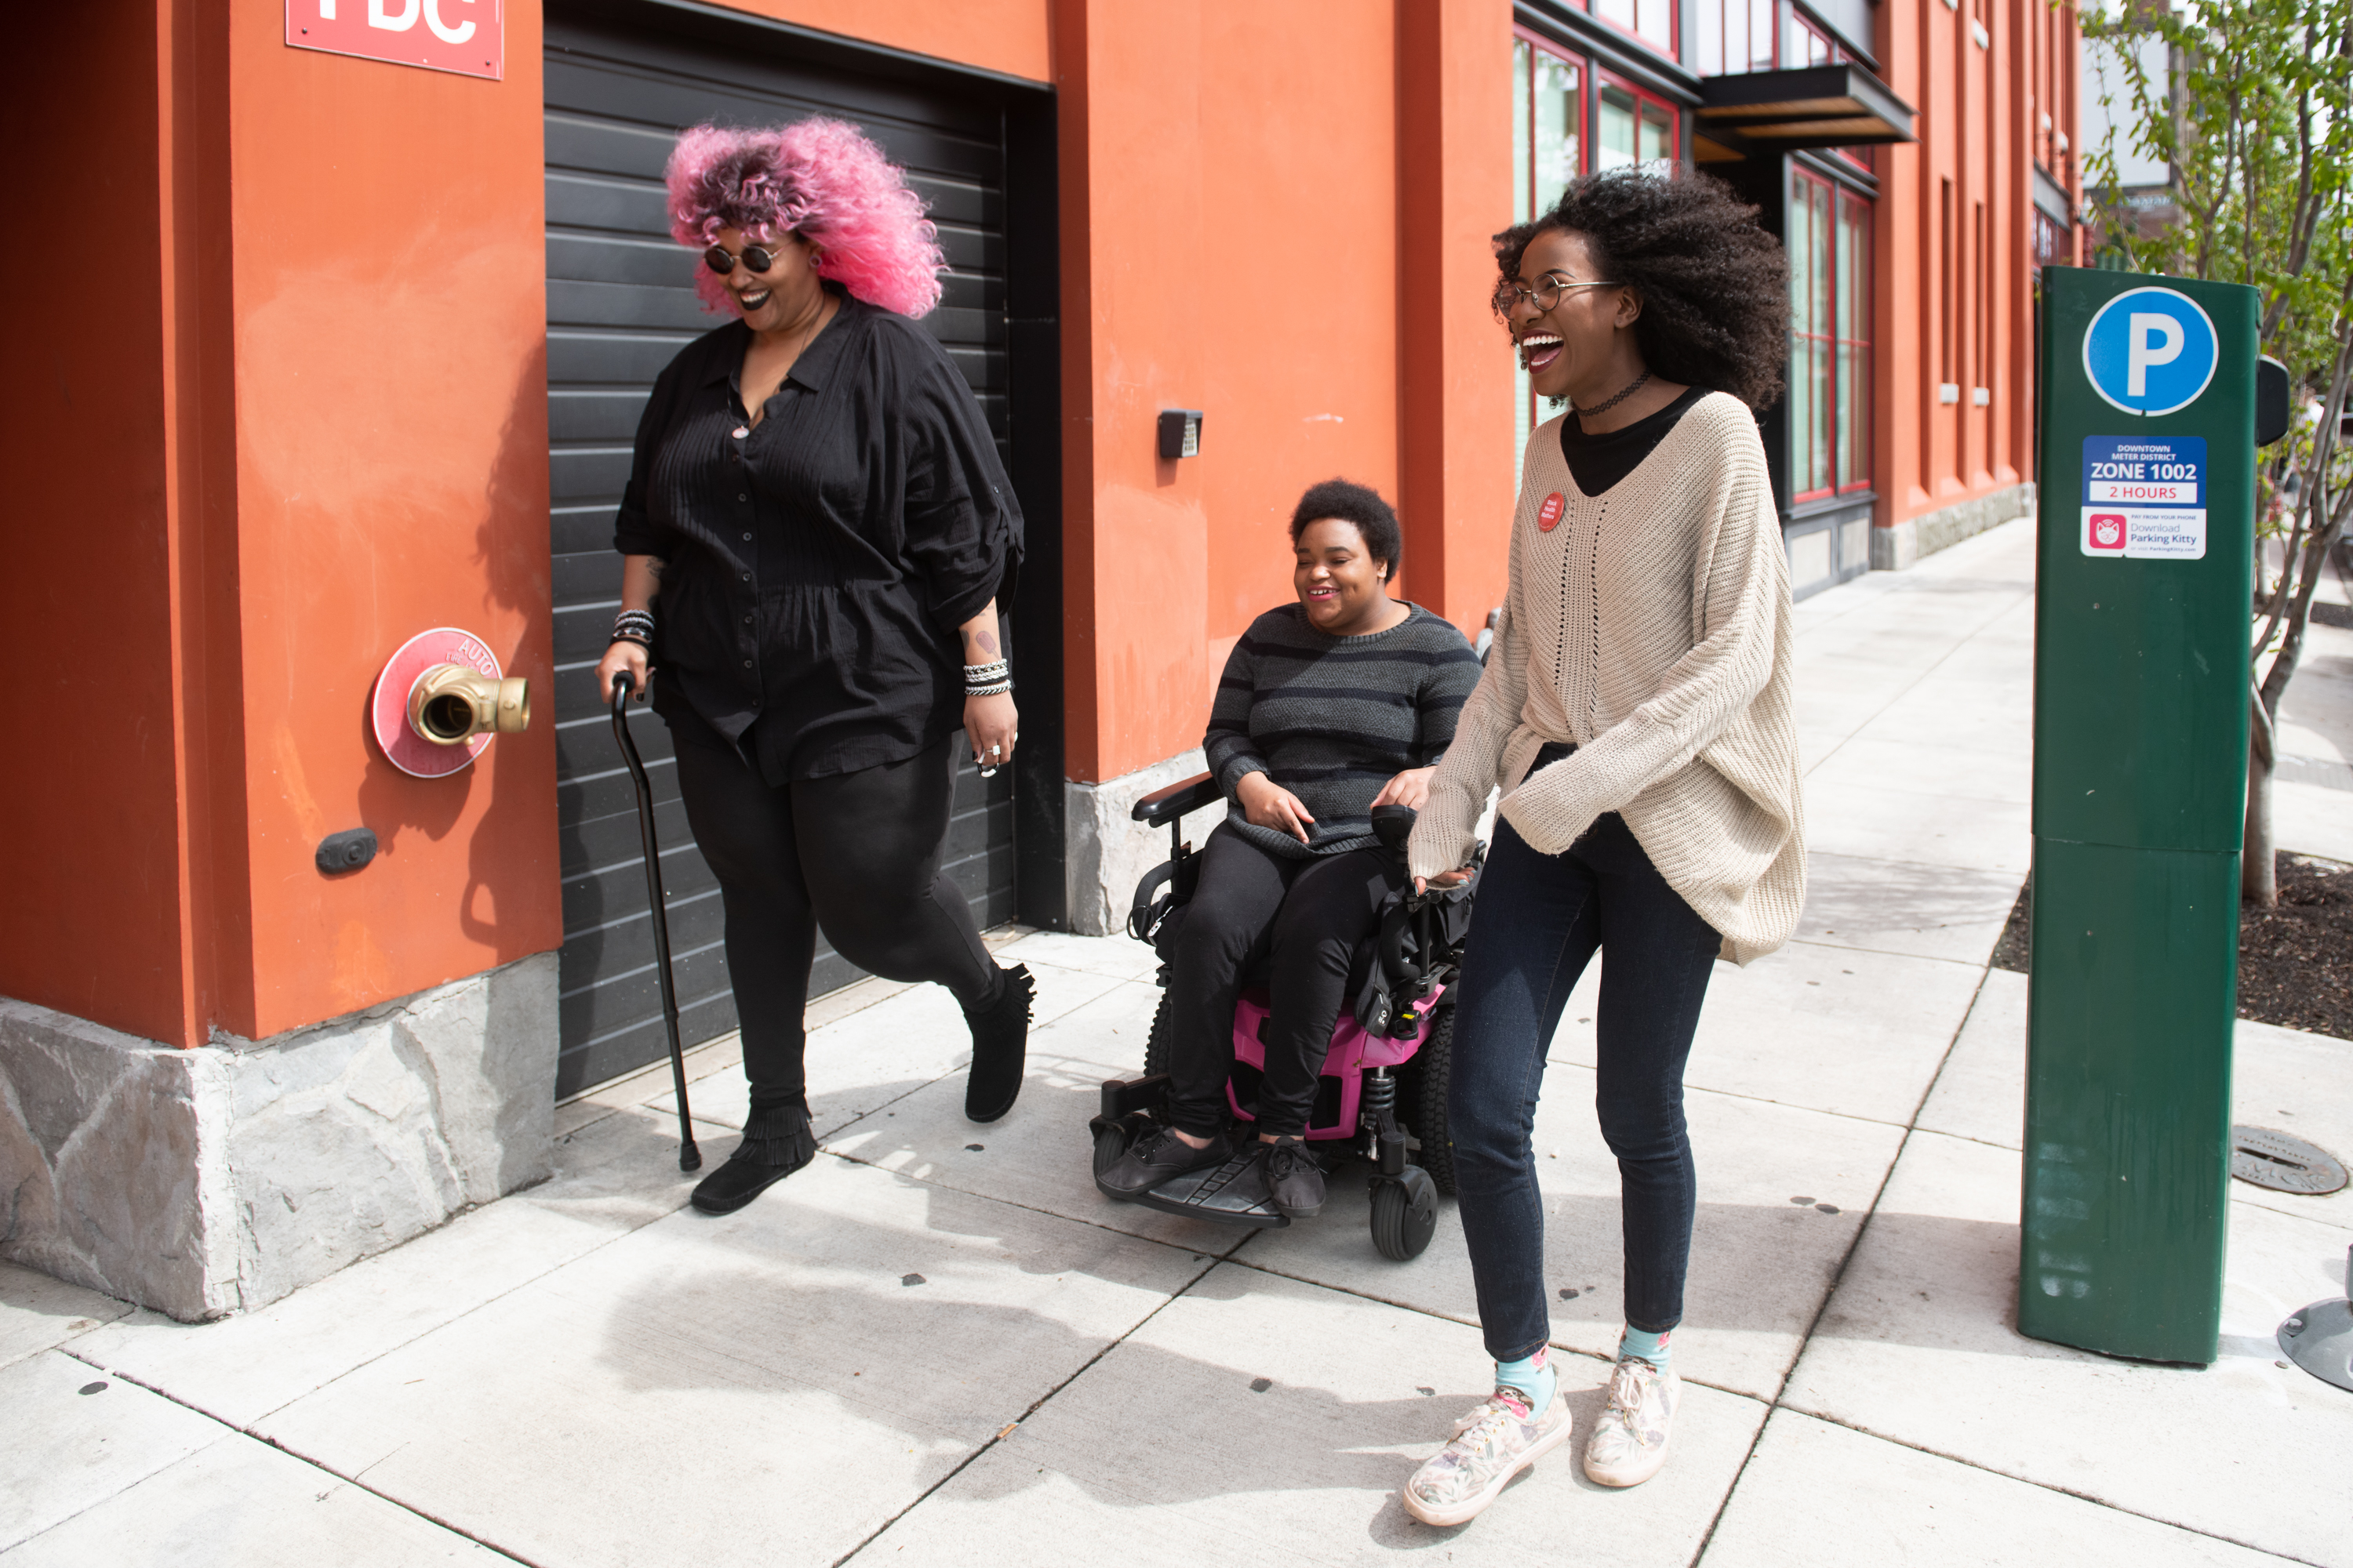
We have a lot going on.
Notes:
Caption: Three Black and disabled folx laugh uproariously while strolling down a sidewalk on a windy day. On the left, a non-binary person walks with a cane in one hand and a tangle stim toy in the other. In the middle, a non-binary person rolls along in their power wheelchair. On the right, a femme walks with fabulously windswept hair. A street parking meter is in the background on the right.
Source: https://affecttheverb.com/gallery/disabledandhere/windsweptwalking/

Slide 20
Accessibility programs
Testing
Training
Communication
Governance
Tools
Politics
Notes:
Accessibility lies at the center of a coalition of people who are invested in this work!

Slide 21
Processes versus practices
Process
Practice
How things are supposed to get done
How things actually get done

Slide 22
Practices demonstrate patterns
Who has power?
Who is trusted?
Where are resources spent?
What initiatives succeed?
Notes:
Once you observe how people actually do work for long enough, a lot of information under the surface starts to come into focus

Slide 23
Systems help us manage our energy, time, and effort.

Slide 24
Community and systems work together
…shows us how people work, which we can use when we create…
Community
Systems
…help us focus on…

Slide 25
Getting started with accessibility operations

Slide 26
What is accessibility operations?
Accessibility operations is the philosophy and practice of connecting people, technology, and processes to create, maintain, and improve accessibility for products and services.

Slide 27
Foundations of accessibility operations
Affinity
Enablement
Find common cause and grow trust by working together
Reduce friction and change climate by helping people help themselves
Notes:
Use community to build affinity and trust; connecting people together
Use systems to build enablement and literacy so people in the community who trust you can get better at using resources and making decisions on their own

Slide 28
Affinity snowballs
Collaborate to address real problems
Identify common causes
Connect people in community
You
Notes:
Problems might be shared or might not be! They might be adjacent problems that people in coalition decide to work on.

Slide 29
Communities of practice
People
Relationships
Diversity
Social complexity
Community maintenance
Notes:
Adapted from a diagram in The Accessibility Operations Guidebook, adapted from a similar diagram in Communities of Practice (Wenger).

Slide 30
Communities of practice
Purpose
Affinity
Mutual accountability
Negotiation
Interpretation
Identity
Notes:
Adapted from a diagram in The Accessibility Operations Guidebook, adapted from a similar diagram in Communities of Practice (Wenger).

Slide 31
Communities of practice
Practice
Stories
Tools
Events
Artifacts
Actions
Notes:
Adapted from a diagram in The Accessibility Operations Guidebook, adapted from a similar diagram in Communities of Practice (Wenger).

Slide 32
You probably already have these!
Resource groups
Champion networks
Assembled to help folks with similar experiences navigate systems
Assembled to scale learning and practice
Notes:
Examples of things these groups might do:
Sus out practice, teach new topics, find points of affinity,

Slide 33
—Etienne Wenger in Communities of Practice: Learning, Meaning, and Identity
A connection point
“Communities of practice are the locus of ‘real work.’ Their practices are where the formal rests on the informal, where the visible counts on the invisible, where the official meets the everyday. Designing processes and policies is important, but in the end it is practice that produces results, not the processes and policies.”

Slide 34
Accessibility communities of practice
Attract people who are in the weeds of advocacy, technology, and policy work
Membership is usually self-selected
Members are looking for:
Real, practical solutions
Collaborators, sponsors, and allies
Mutual support and accountability

Slide 35
Communities of practice enable
A view into how teams work
An audience for informal learning
Collaborators in experiments with tools, processes, and workflows
A high-level view to identify patterns and pain points
And incubator for solutions that come from actual needs

Slide 36
Accessibility programs revisited
Testing
Training
Communication
Governance
Tools
Politics
Notes:
Bringing these back to address doing these from an operations standpoint:
Communication: Put your content where you know people already (newsletters, meetings, documentation, resources)
Training: Train people to not just do things, but understand why they’re doing them (this is how adults learn best, but also how to grow literacy)
Governance: Prioritize impacting the largest number of people or the biggest source of harm
Be a social scientist!

Slide 37
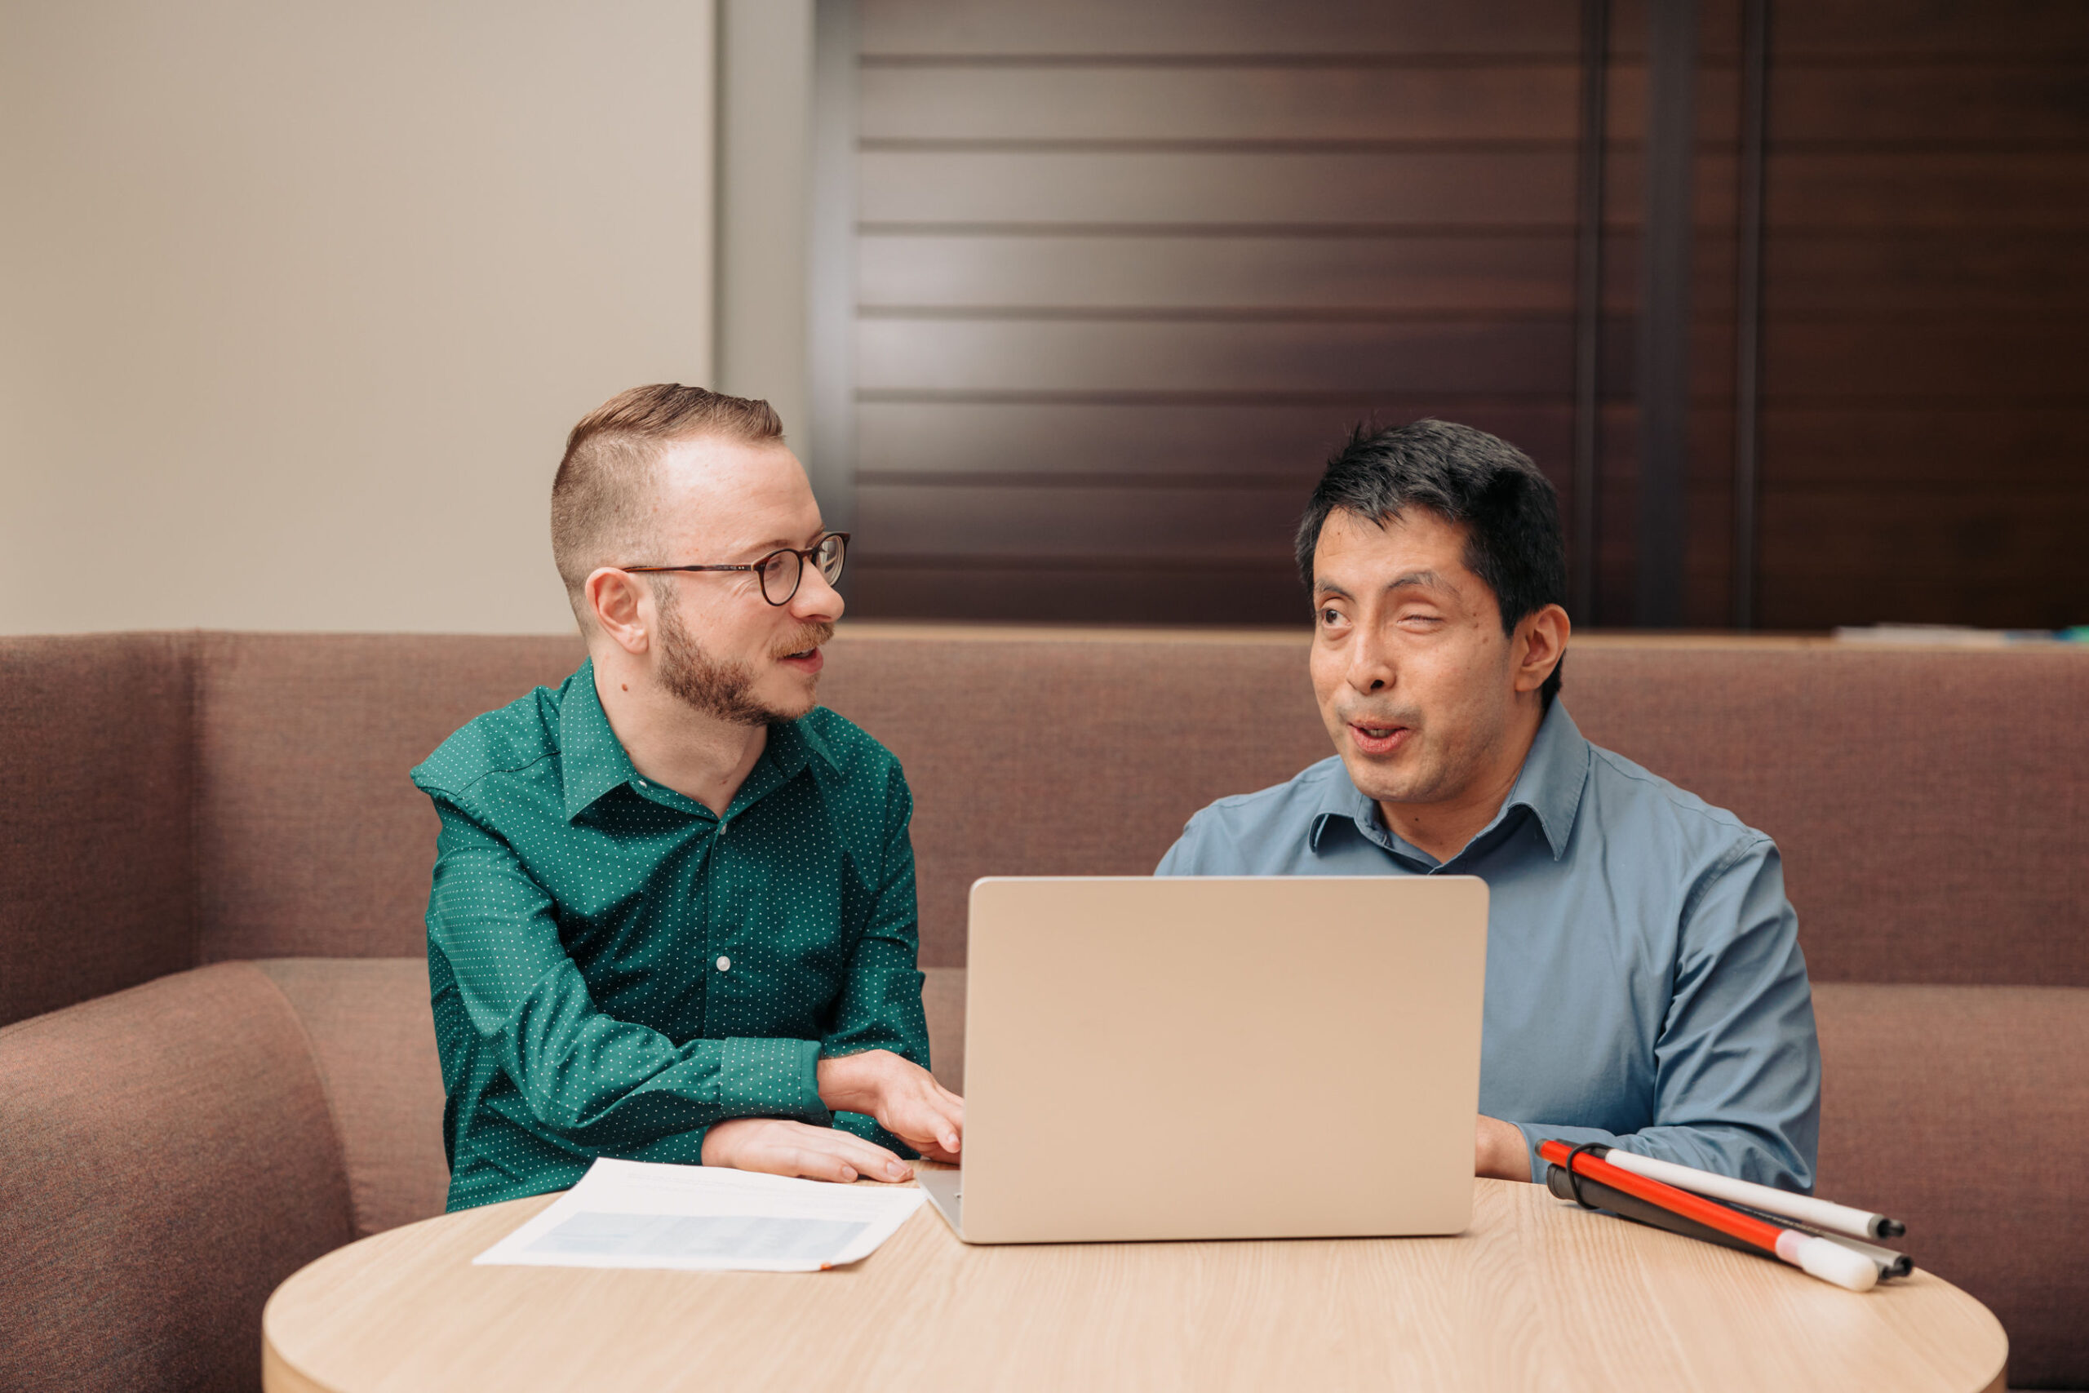
Make it easy to find you.*
Notes:
And by “you” I mean your stuff
Caption: Two colleagues working together on a laptop in an office. One man has his white cane folded on the desk next to the laptop.
Source: https://disabilityin.org/resource/corporate-disability-stock-photography

Slide 38
*Your resources
Slide decks
Recordings
Documentation
Training materials
Reports
Office hours
Community meetings
(And please make them all accessible.)

Slide 39
Meet people where they’re already going for information
Make allies with
Contribute to
Learning designers
Knowledge managers
Librarians
Project coordinators
Role-specific handbooks
Process documentation
Department newsletters
Annual training cycles
Just-in-time learning

Slide 40
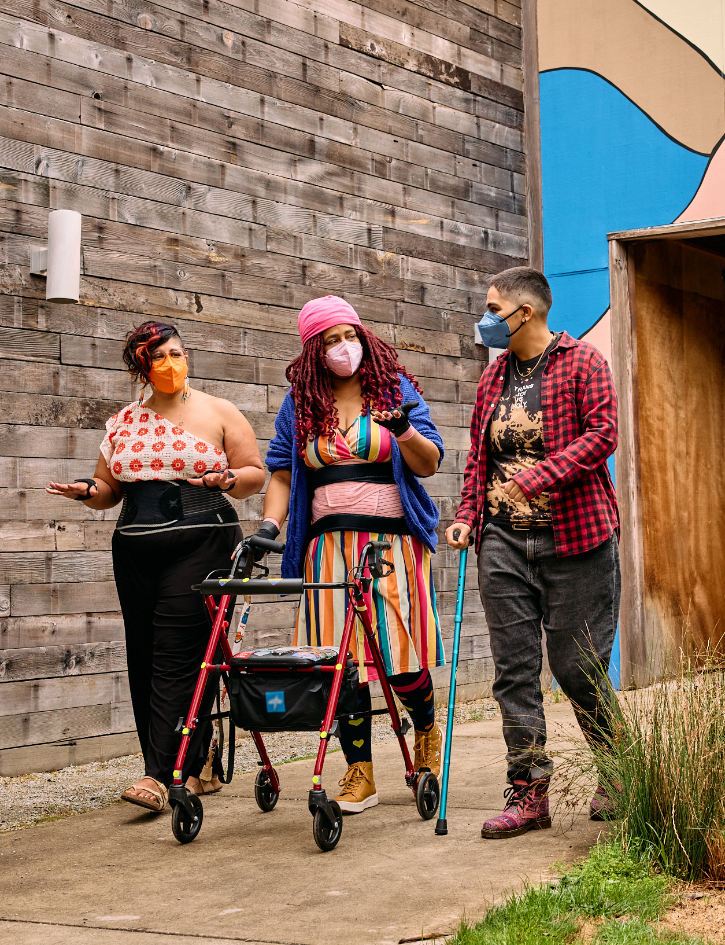
Being anti-ableist in our work
Collaboration
Accommodation
Flexibility
Intersectionality
Anti-perfectionist
Working joyfully, not compulsively
Notes:
I mean this in both how we do the work and what our work represents
Caption: Three masked disabled people of color chat while strolling through an outdoor courtyard. On the left, an Indigenous woman wears glasses, wrist support braces, and waist trainers paired with a off-shoulder top and wide leg pants. In the middle, a Black non-binary woman walks with a rollator and wears waist trainers with ice pack inserts over their rainbow striped dress. On the right, a Latinx non-binary person walks while using a teal functional grip cane.
Source: https://affecttheverb.com/gallery/disabledandhere/walkthrough/

Slide 41
Enable community members to learn on their own, in the context of their work, and at their own pace.
Notes:
“Learn on their own” doesn’t have to mean alone, it can mean starting a study group, a book club, a code review session, etc.

Slide 42
Enable community members to learn from each other in the context of real problems.
Notes:
Also flexibility

Slide 43
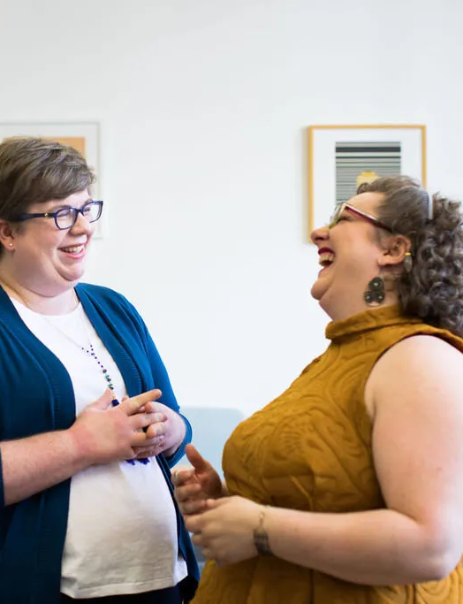
Reward community members for creativity, critical thinking, sharing, and collaboration, not for compliance.
Notes:
Source: https://canweallgo.com/plus-size-stock-photos/plus-size-stock-photos-office-work-employment/

Slide 44
Remember information literacy 101
When and where is it from?
Who made it?
Why was it made?
Who benefited from it when it was made?
Who benefits from it now?

Slide 45
Help people answer these questions
What guidelines and practices apply to me?
Who can I trust in the space? Why?
What tools and resources are available to me?
Where and how can I learn more when I need to?
Am I reducing harm to people with disabilities?

Slide 46
Mentor, don’t manage.
Notes:
Also flexibility

Slide 47
Decrease friction
Create
Facilitate
One-to-many communication
Learning in context
Many small changes over time
A lot of people knowing a little, instead of a few people knowing a lot
Critical thinking
Realistic goalsetting

Slide 48
Prioritize what will reduce harm the most.
Notes:
Also flexibility

Slide 49
Don’t wait for leadership.
Notes:
Also flexibility

Slide 50
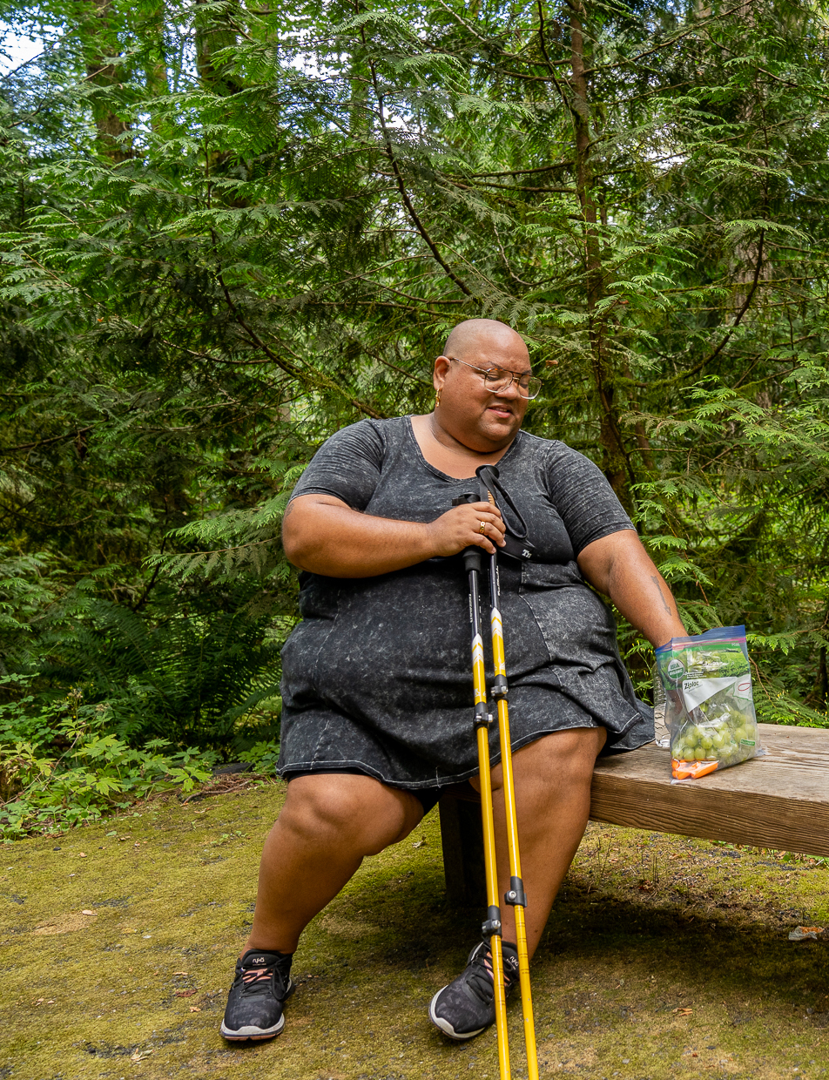
Take a rest, then get back to the work.
We need you, and we’re all in this together for the long haul!
Notes:
Image description: A disabled Black non-binary hiker sits and reaches into a bag of grapes and carrots. They are holding trekking poles and resting on a wooden bench surrounded by forestry. The hiker has a shaved head and wears glasses, a peplum shirt, shorts, and tennis shoes.
Image source: https://affecttheverb.com/gallery/disabledandhere/restbreak/

Slide 51

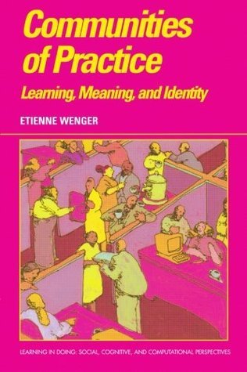
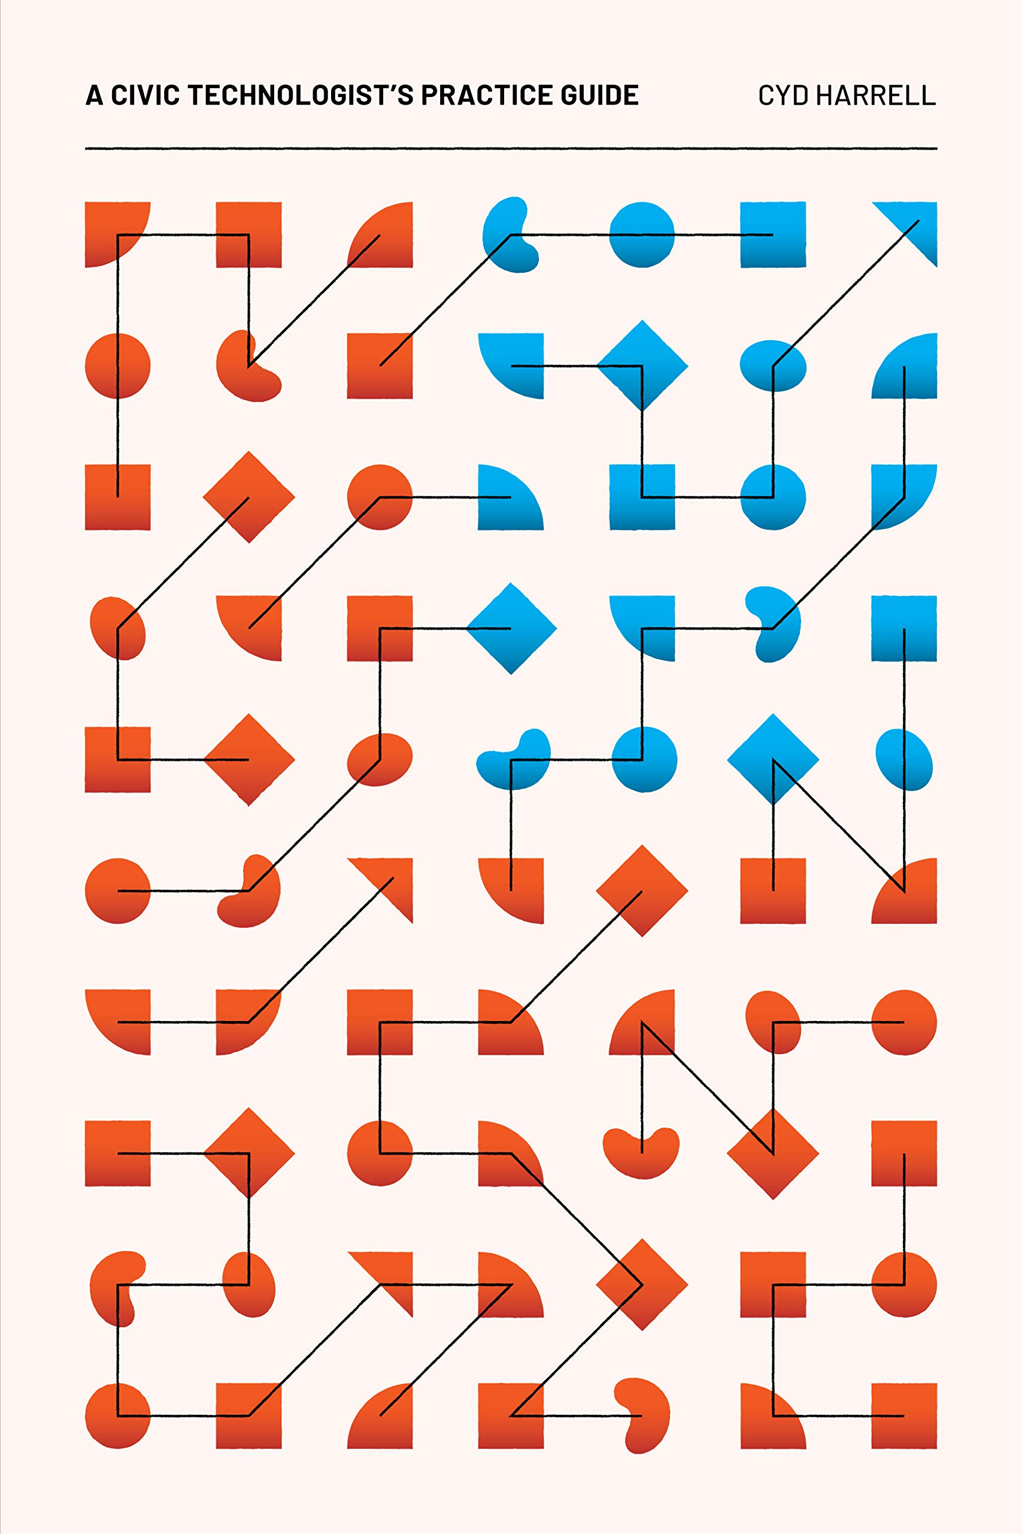
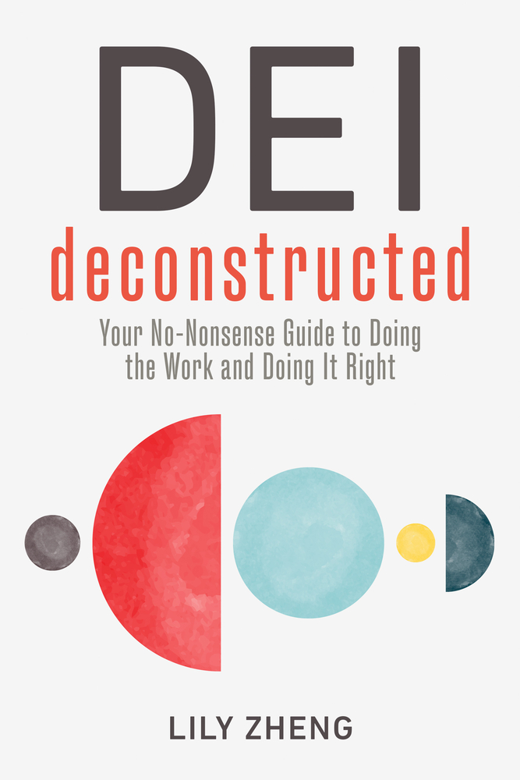
Resources
A Civil Technologist’s Practice Guide
Cyd Harrell
Thinking in Systems Donella H. Meadows
Communities of Practice
Etienne Wenger
DEI Deconstructed
Lily Zheng

Slide 52
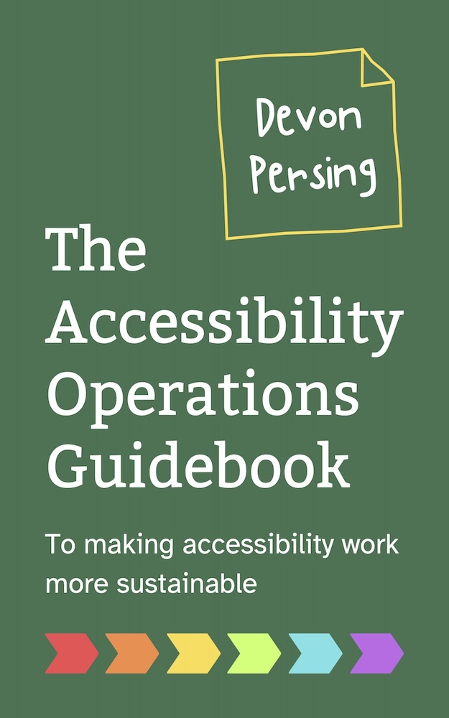
Thank you!
Ebook
dpersing.com
devonpersing on LinkedIn and Bluesky
Paperback

